Slide 1

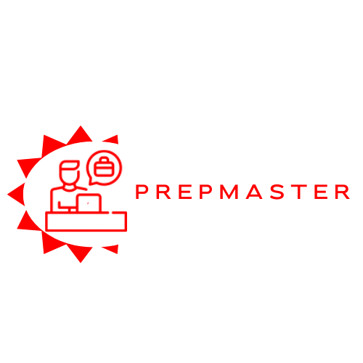


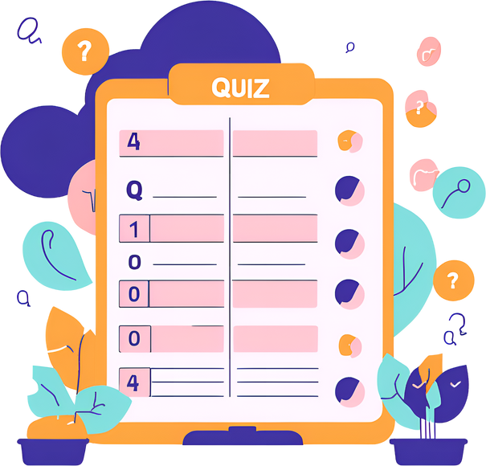



SRI LANKA INSTITUTE OF INFORMATION TECHNOLOGY
Enhancing Interview Preparedness:
A Comprehensive Web Application.
Progress Presentation II
24-25J-082
3/19/2025
1

Slide 2

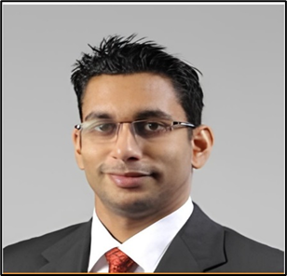
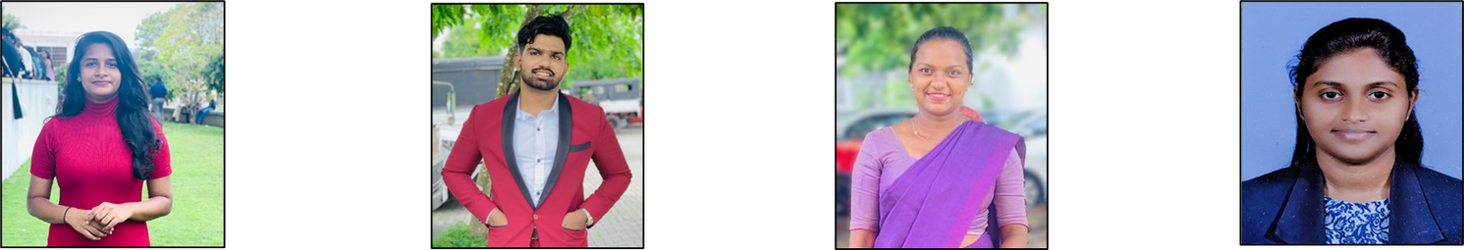
OUR TEAM
MR. S.M.B. HARSHANATH
DR. HARINDA FERNANDO
PATHIRANA V.P.E.P.V.
(Leader)
SENEVIRATHNA
D.M.O.C.
KAVINDYA N.D.D.
SATHKUMARA
S.M.P.U.
3/16/2025
2

Slide 3



AGENDA
Introduction
Research Problem
Main Objective
System Diagram
Technologies
Individual Components
4
5
6
7
8
9
3/16/2025
3

Slide 4



INTRODUCTION
1
In today’s competitive job market, being well-prepared for interviews is crucial. Our project aims to create a web application that uses machine learning to help users get ready for interviews.
2
3
4
The app will provide personalized quiz assessments to identify strengths and areas for improvement, suggest videos for learning specific skills, offer virtual interview practice with realistic avatars.
5
6
7
8
These features will boost confidence, enhance skills, and provide the necessary tools for users to succeed in their job search.
9
3/16/2025
4

Slide 5
RESEARCH PROBLEM
1
2
Lack of Personalized MCQ Systems
Overwhelming Interview Preparation Content
Limited Realistic Interview Practice
Lack of identify the current skills and job roles
3
4
5
6
7
8
9
3/16/2025
5

Slide 6
MAIN OBJECTIVE
1
The main objective of this research is to develop a comprehensive web application that enhances interview preparedness through the integration of machine learning techniques.
The platform aims to improve user experience and learning outcomes by offering tailored MCQ assessments, personalized video recommendations, simulated interview panels, and customized CV generation.
2
3
4
5
6
7
8
9
3/16/2025
6

Slide 7
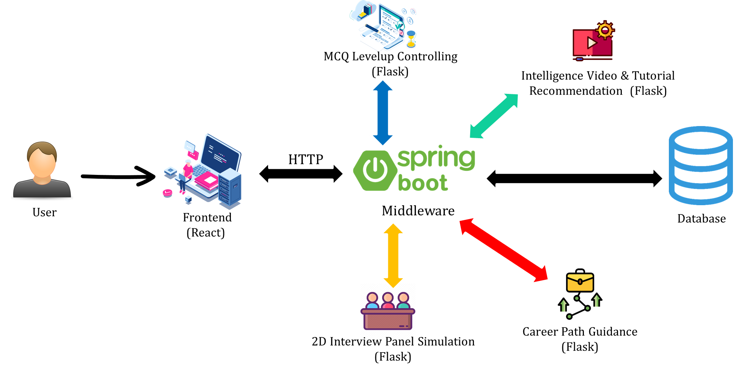
SYSTEM DIAGRAM
1
2
3
4
5
6
7
8
9
3/16/2025
7

Slide 8
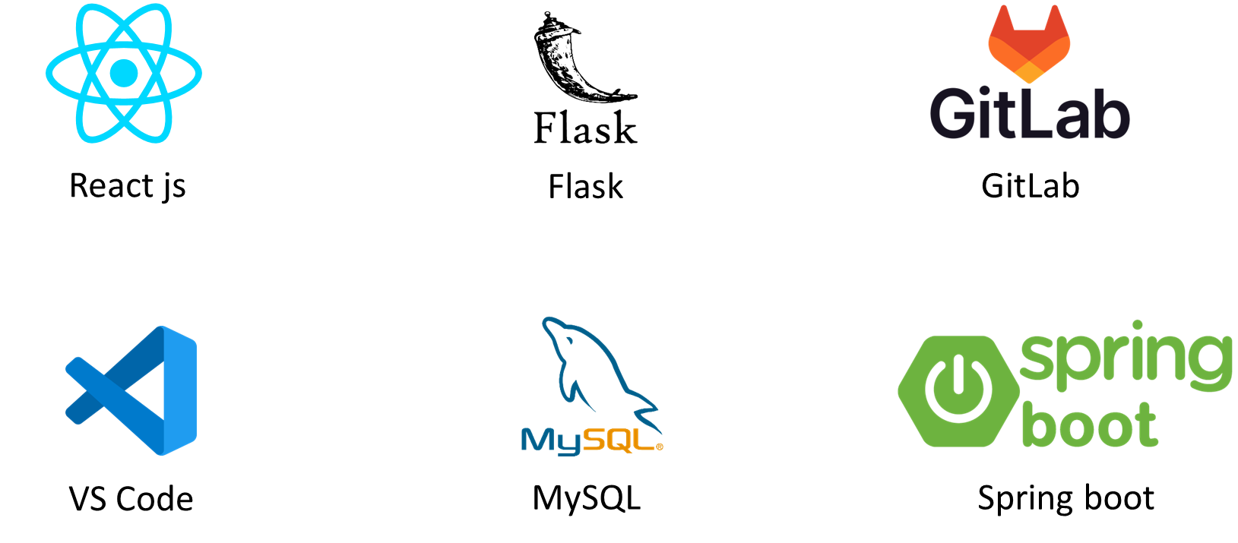
TECHNOLOGIES
1
2
3
4
5
6
7
8
9
3/16/2025
8

Slide 9



IT21306136 | Sathkumara S M P U
Specialization - Information Technology
Component 1 - AI-Powered Skill Gap Analysis & Career Learning Path Guidance
3/16/2025
9

Slide 10
Introduction
Addressing Modern Career Challenges
Developed in response to evolving job market demands.
Helps individuals navigate rapid industry changes and new job roles.
Limitations of Traditional Career Counseling
Lacks personalization and real-time insights.
Does not effectively guide job seekers in a dynamic market.
AI-Powered Learning Guidance
Uses AI & ML for identity skills.
Provides skill gap analysis and job market insights.
Empowers users with customized learning plans for job readiness.
3/16/2025
10

Slide 11
Research Gap
•Personalization and Contextual Understanding
•Integration of Real-Time Market Data
•Skill Gap Analysis
•User Engagement and Feedback Mechanisms
3/16/2025
11

Slide 12


Research Gap
 | RESEARCH [1] | RESEARCH [2] | RESEARCH [3] | Proposed Solution
Personalization and Contextual Understanding
Skill Gap Analysis
Integration of Real-Time Market Data
3/16/2025
12

Slide 13
Research Problem
How can an AI-powered career guidance system, utilizing machine learning algorithms, provide personalized and accurate learning path recommendations to improve users' career decision-making and job readiness?
What is the impact of integrating real-time job market data and dynamic skill gap analysis on the effectiveness and relevance of learning guidance provided by AI-powered systems
3/16/2025
13

Slide 14
Specific Objectives
Utilize advanced machine learning to analyze users' skills, compare them with industry requirements, and provide targeted learning plans to enhance job readiness.
Provide tailored job recommendations and market insights.
3/16/2025
14

Slide 15
Sub Objectives
•Enhance Personalization
•Integrate Real-Time Market Data
•Improve Skill Gap Analysis
•Incorporate User Feedback
3/16/2025
15

Slide 16
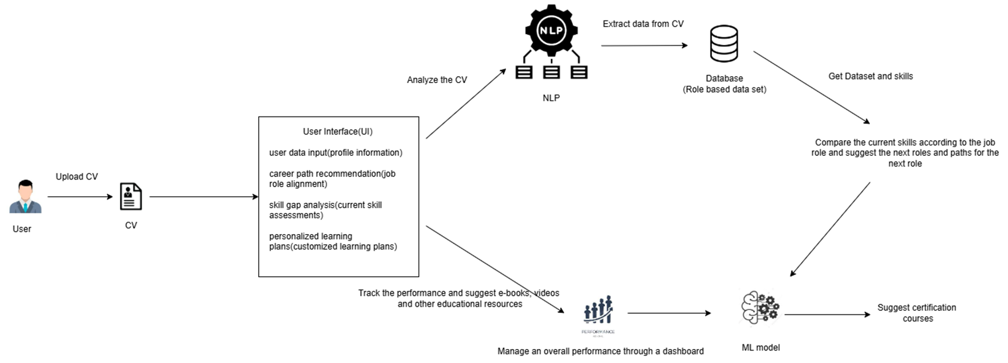
System Diagram
3/16/2025
16

Slide 17
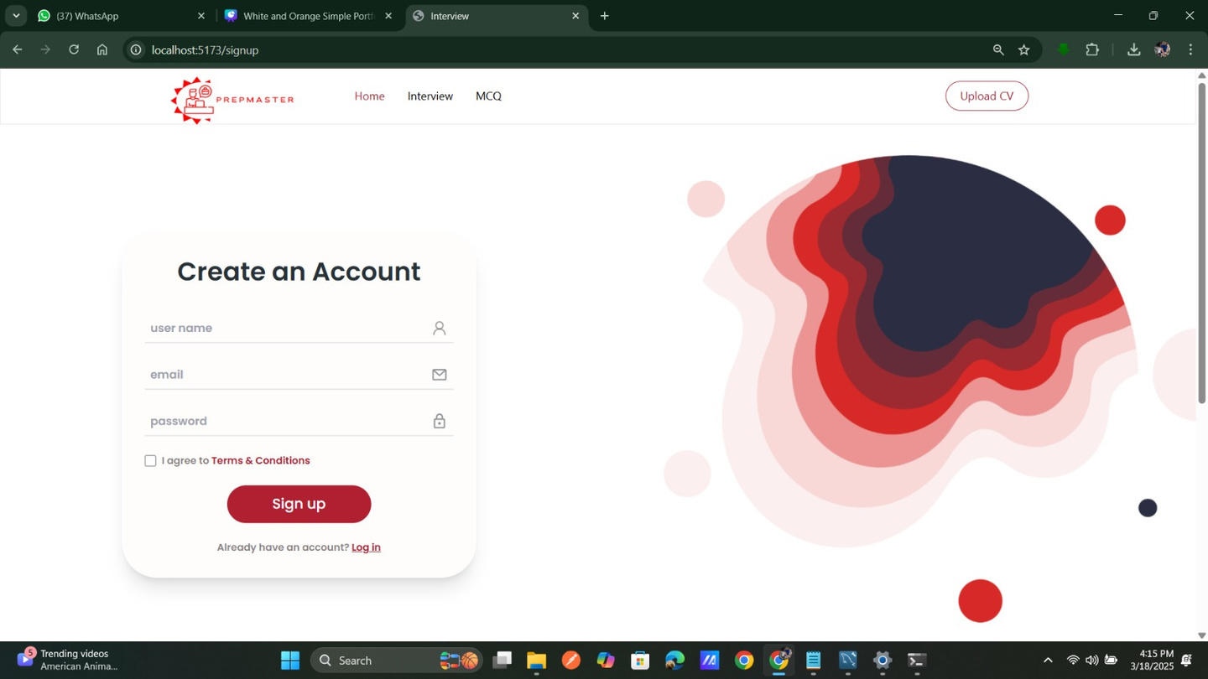
Evidence of Completion
3/16/2025
17

Slide 18
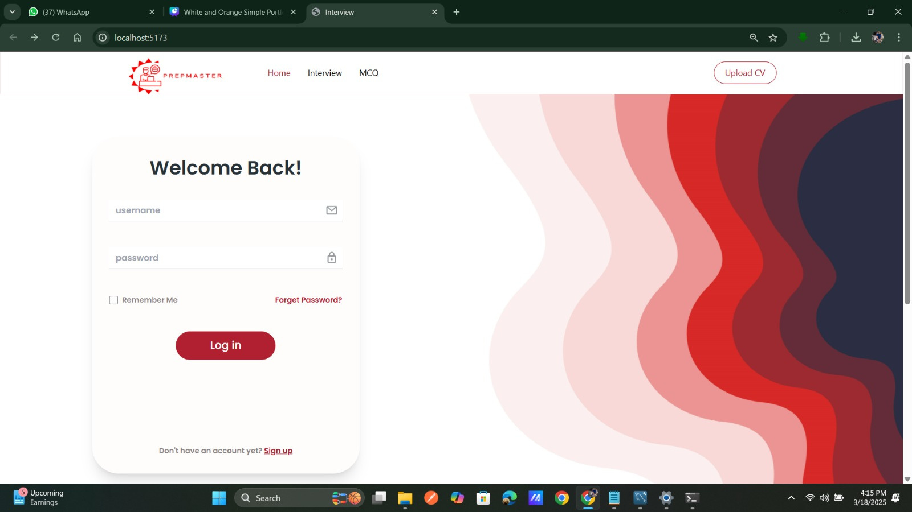
Evidence of Completion
3/16/2025
17

Slide 19
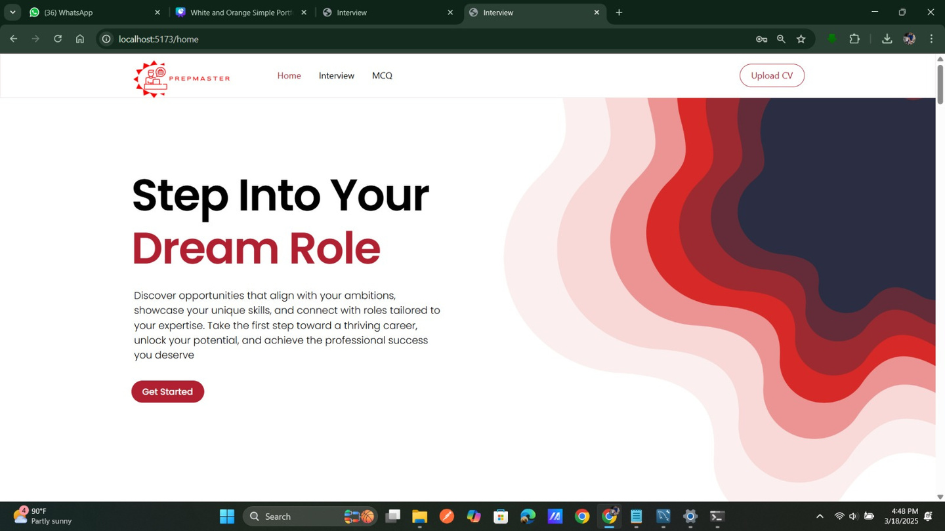
Evidence of Completion
3/16/2025
17

Slide 20
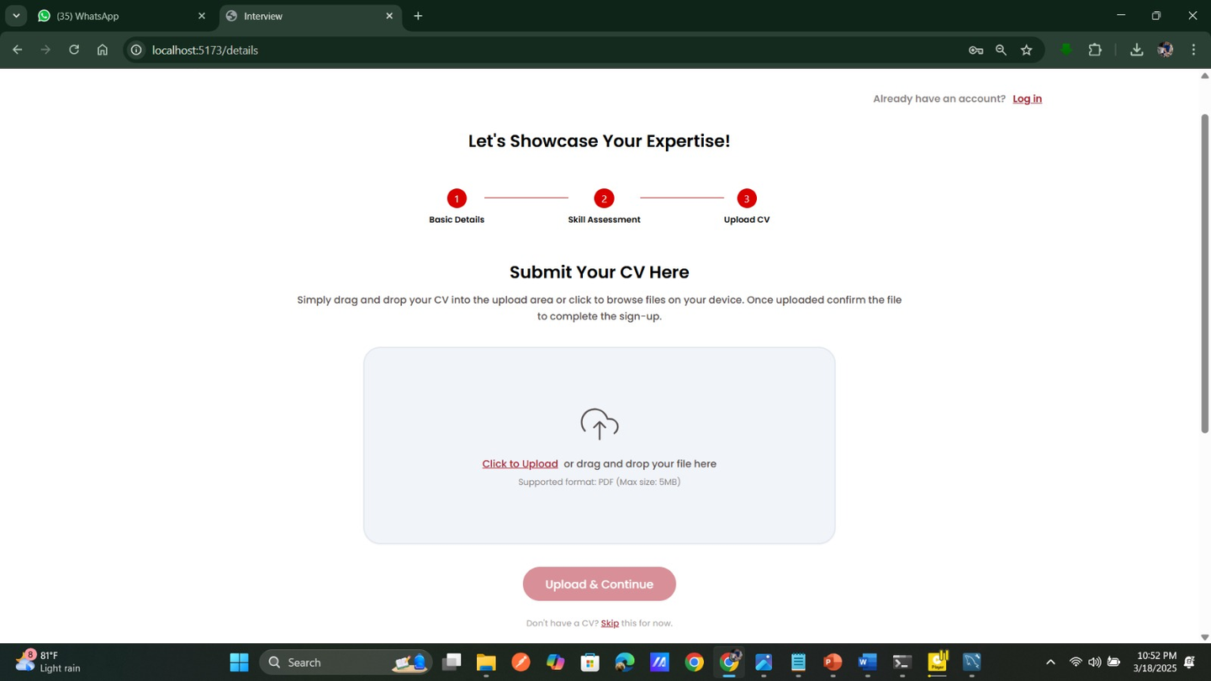
Evidence of Completion
3/16/2025
17

Slide 21
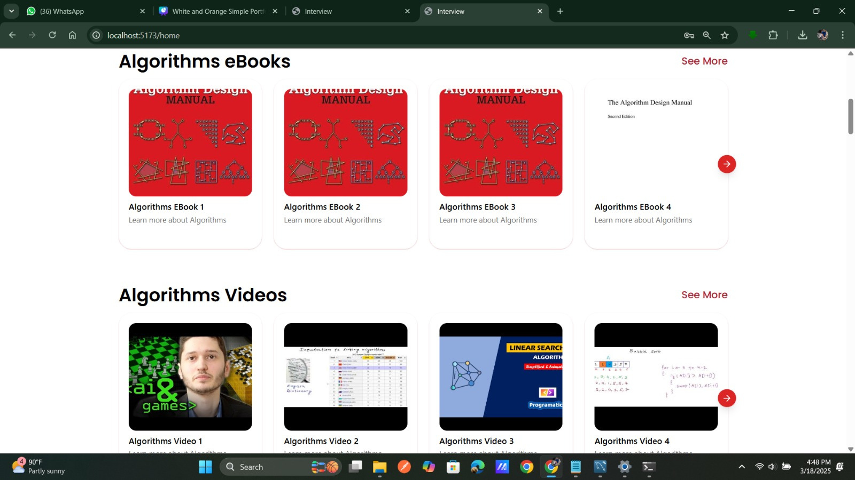
Evidence of Completion
3/16/2025
17

Slide 22
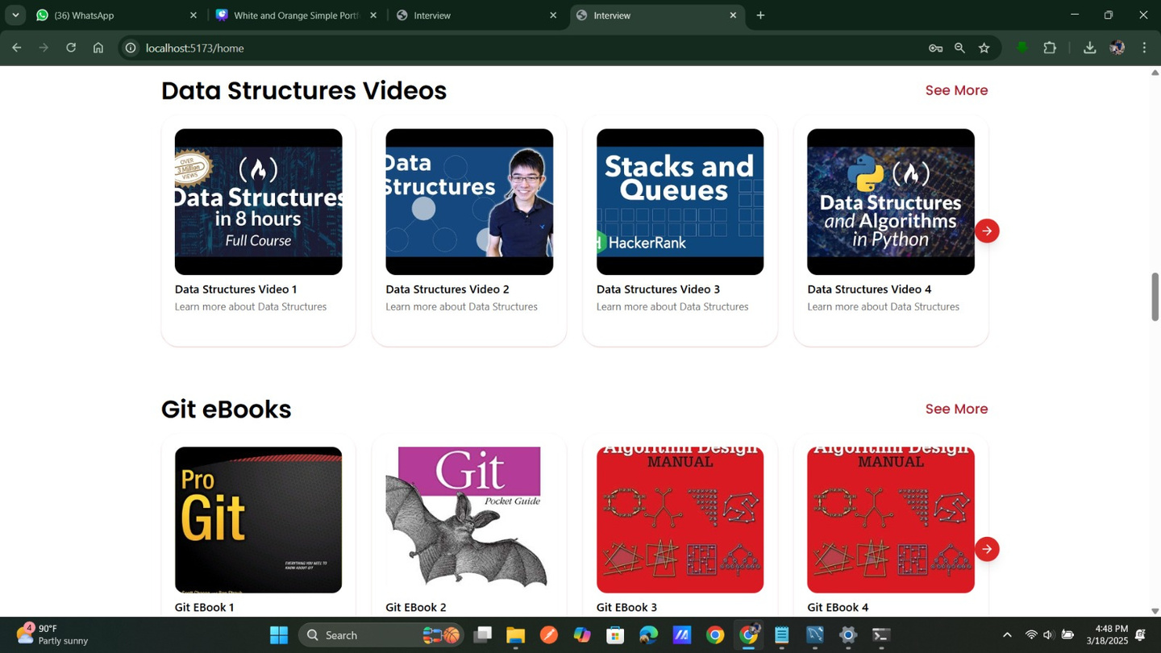
Evidence of Completion
3/16/2025
17

Slide 23
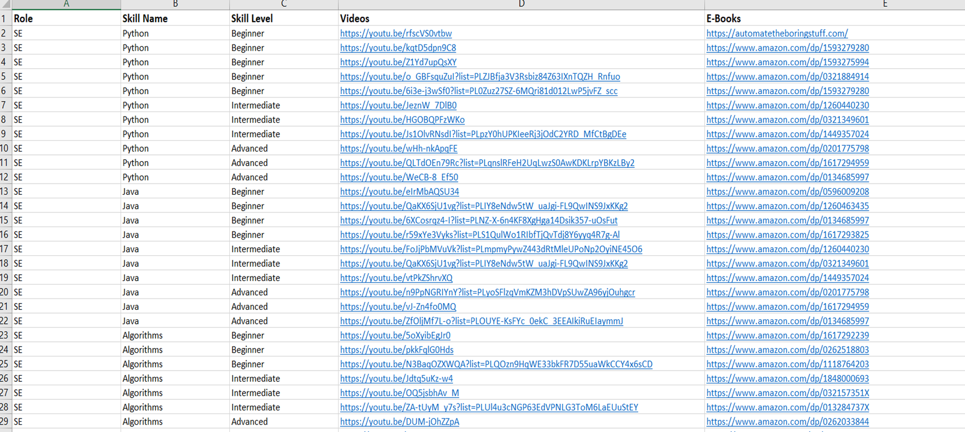
Evidence of Completion
Data Collection
3/16/2025
17

Slide 24
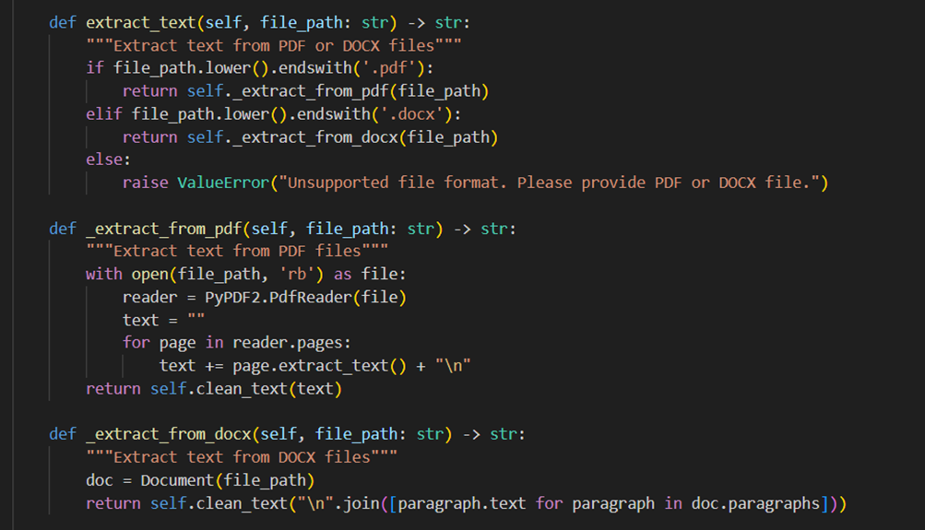
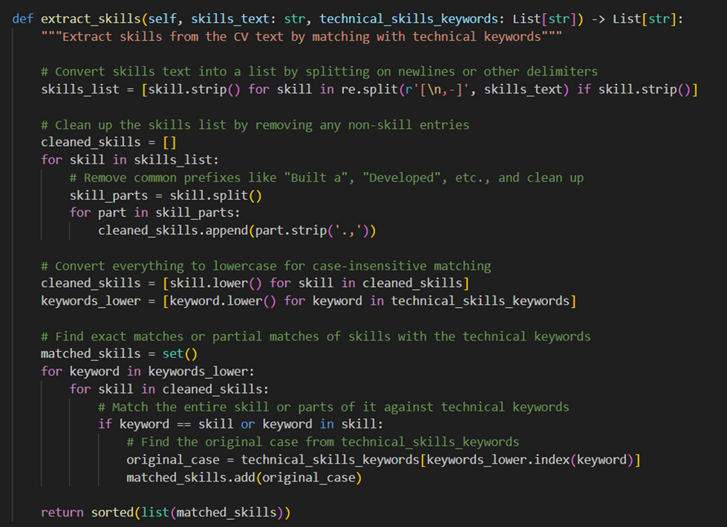
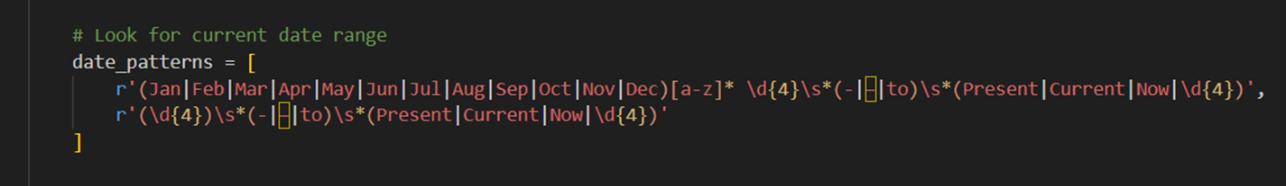
Evidence of Completion
Data Extracting
3/16/2025
17

Slide 25
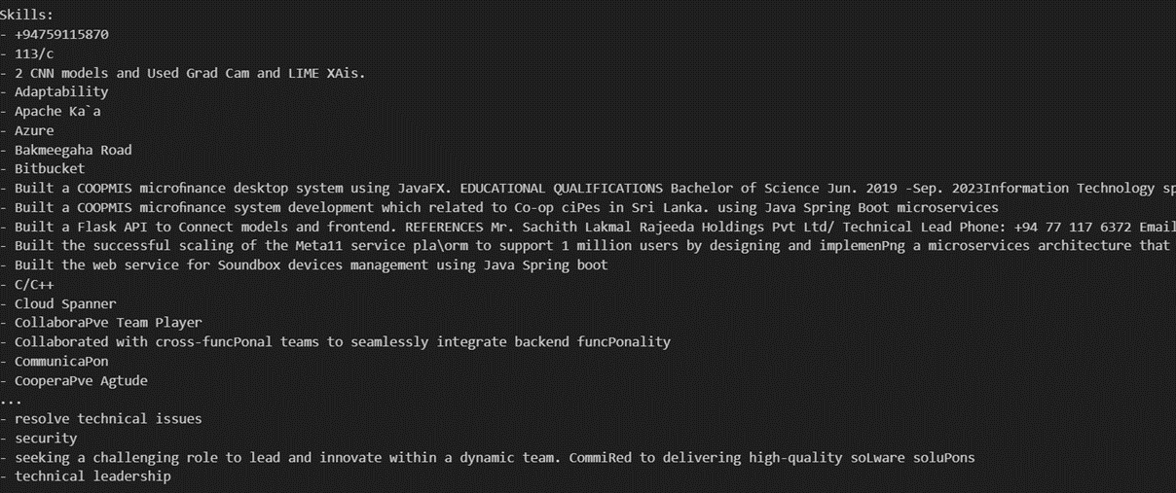
Evidence of Completion
Model Training
3/16/2025
17

Slide 26
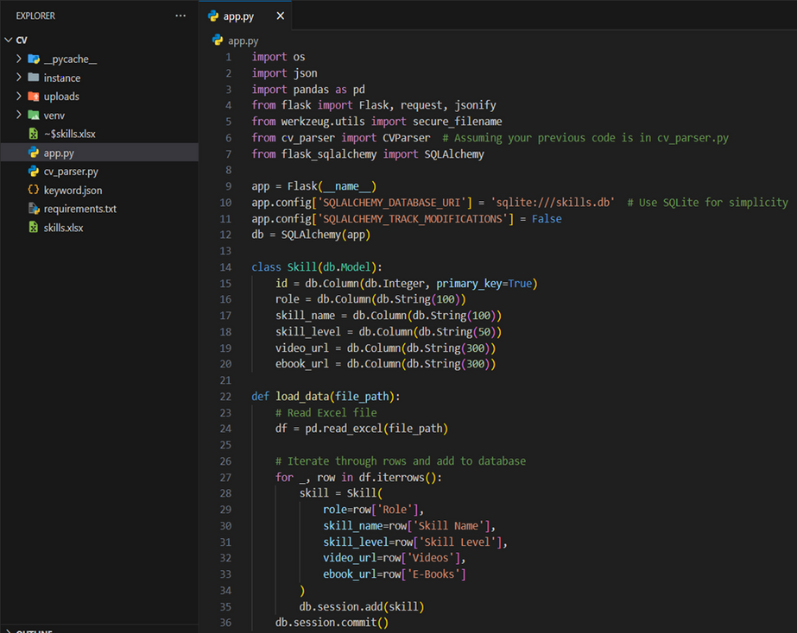
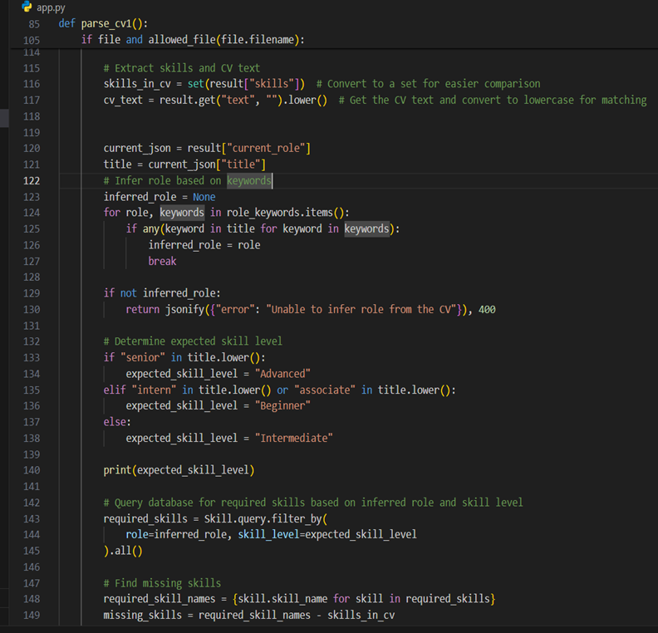
Evidence of Completion
Flask backend
3/16/2025
17

Slide 27
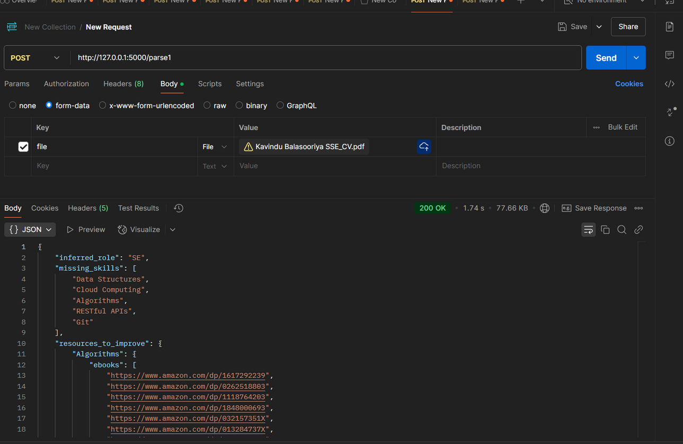
Evidence of Completion
Postman
3/16/2025
17

Slide 28
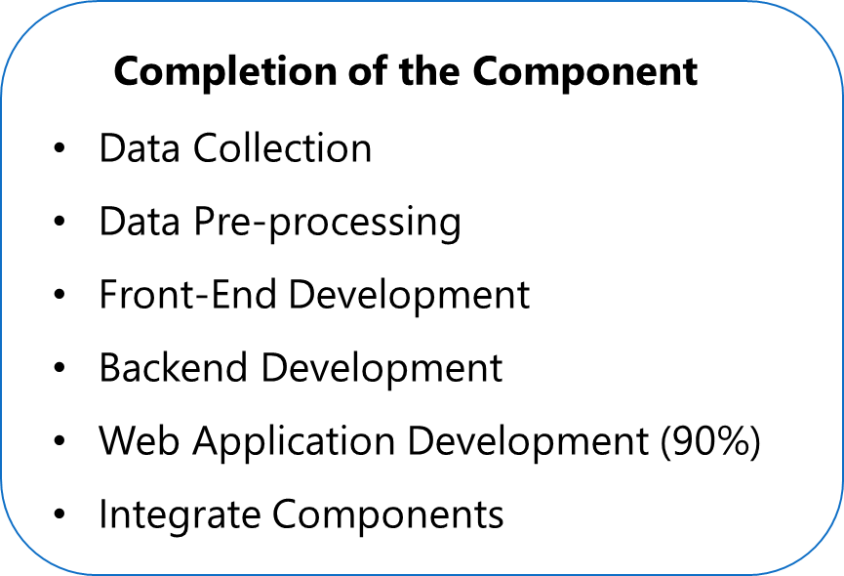
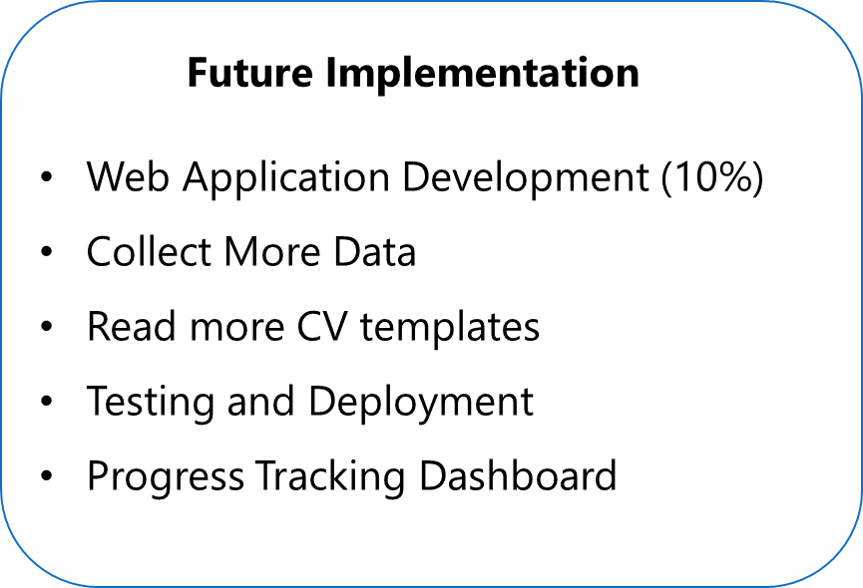
Progress
3/16/2025
26

Slide 29
Functional Requirements
•User Data Collection and Profile Creation
•Extract the user Data
•Personalized Learning Plans
•Skill Gap Analysis
3/16/2025
27

Slide 30
Non-Functional Requirements
•Performance
•Scalability
•Reliability
•Usability
3/16/2025
28

Slide 31
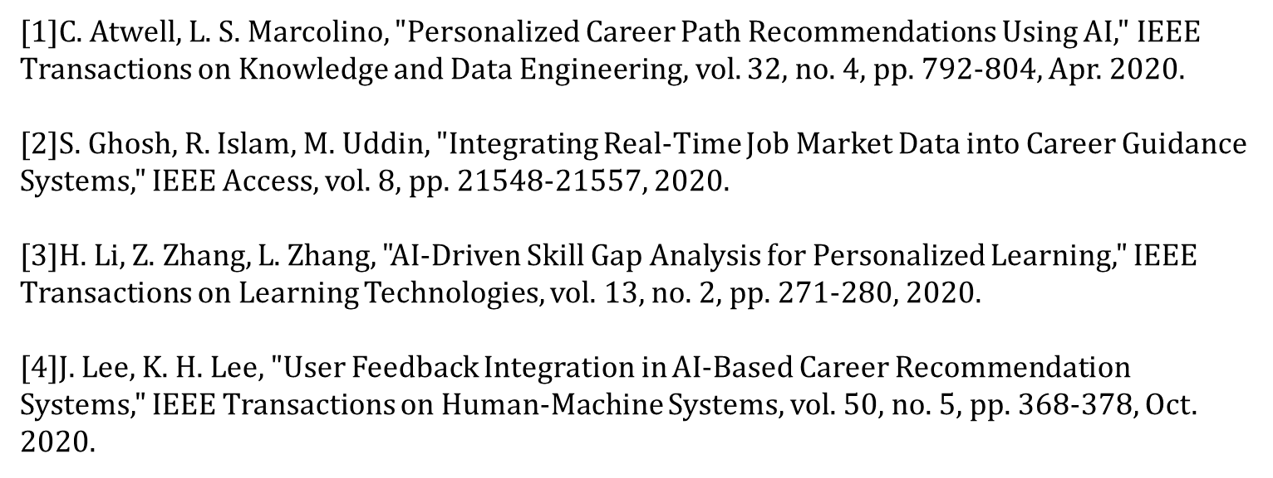
References
3/16/2025
30

Slide 32

IT21231278 | Kavindya N D D
Specialization - Information Technology
Component 2 - Intelligent Video and Tutorial Recommendation
3/19/2025
32

Slide 33
Introduction
The rise of online interview platforms has transformed the recruitment process, making it more efficient and accessible.
Key components of these platforms are video interviews and tutorials. Video interviews allow employers to assess candidates' communication skills and personalities beyond what a resume can show, while tutorials help candidates prepare effectively for the interview process.
Despite their importance, there is limited research on the best practices for integrating these elements to maximize their effectiveness.
This study aims to explore and enhance the design and implementation of video and tutorial features in online interview systems to improve both candidate experience and hiring outcomes.
3/19/2025
33

Slide 34
Research Gap
Impact of Video Interviews on Candidate Evaluation
Effectiveness of Tutorials in Candidate Preparation
User Experience and Accessibility
Integration of AI and Machine Learning
Cultural and Demographic Considerations
3/19/2025
34

Slide 35


Research Gap
 | RESEARCH [1] | RESEARCH [2] | RESEARCH [3] | RESEARCH [4] | Proposed Solution
Impact of Video Interviews on Candidate Evaluation
Effectiveness of Tutorials in Candidate Preparation
User Experience and Accessibility
Integration of AI and Machine Learning
3/19/2025
35

Slide 36

Research Problem
How do video interview formats and tutorial types affect the accuracy and effectiveness of online interviews?
How can we make online interview platforms better for users, and how can AI be used to provide helpful feedback and tutorials while addressing privacy concerns?
3/19/2025
36

Slide 37
Specific Objectives
To enhance the effectiveness of video and tutorial components in online interview platforms by addressing the research gaps and improving candidate evaluation, preparation, user experience, and inclusivity.
3/19/2025
37

Slide 38
Sub Objectives
Evaluate the Impact of Different Video Interview Formats on Candidate Evaluation
Analyze User Experience and Accessibility of Video and Tutorial Components
Investigate the Integration of AI and Machine Learning in Video Interviews and Tutorials
Examine the Impact of Cultural and Demographic Factors on Video Interviews and Tutorials
3/19/2025
38

Slide 39
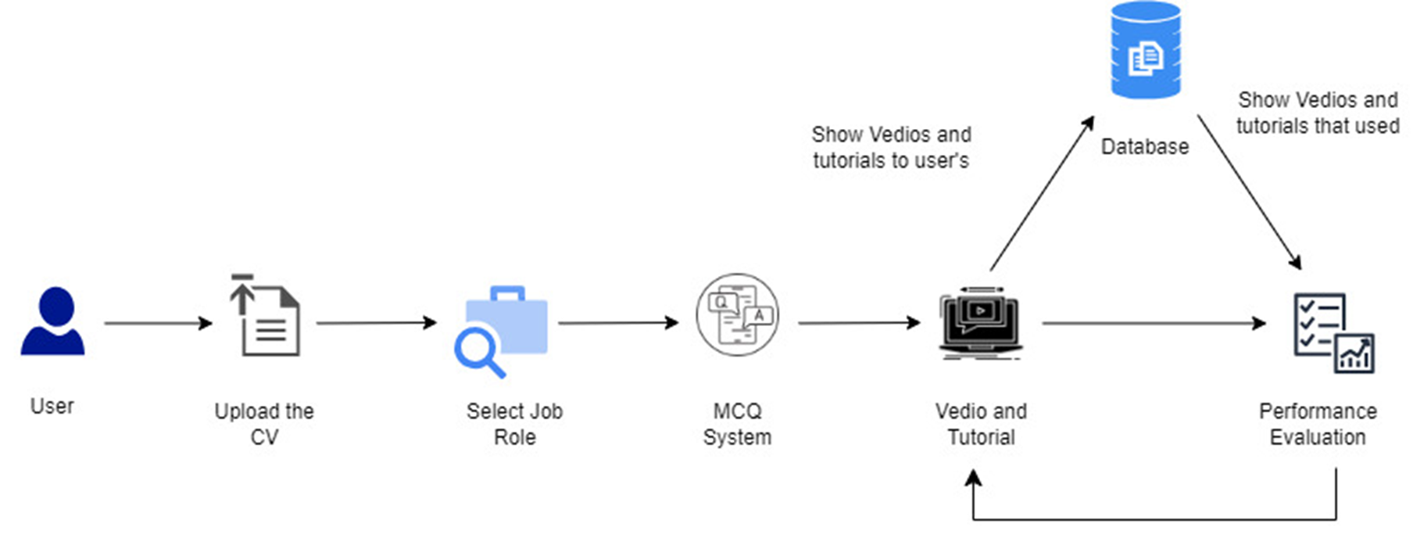
System Diagram
3/19/2025
39

Slide 40

Evidence of Completion
3/19/2025
40

Slide 41
Evidence of Completion
3/19/2025
41

Slide 42
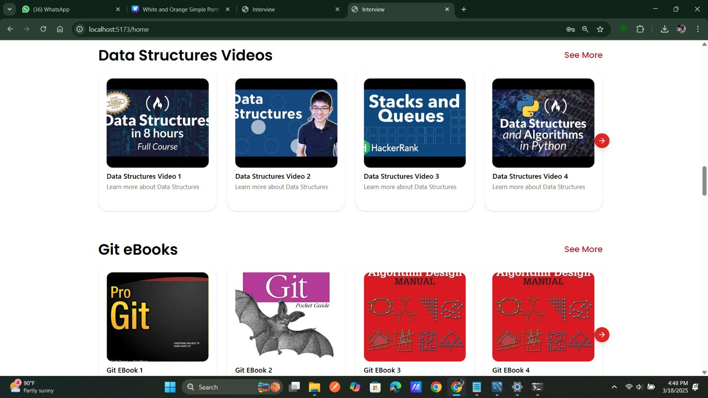
Evidence of Completion
3/19/2025
42

Slide 43
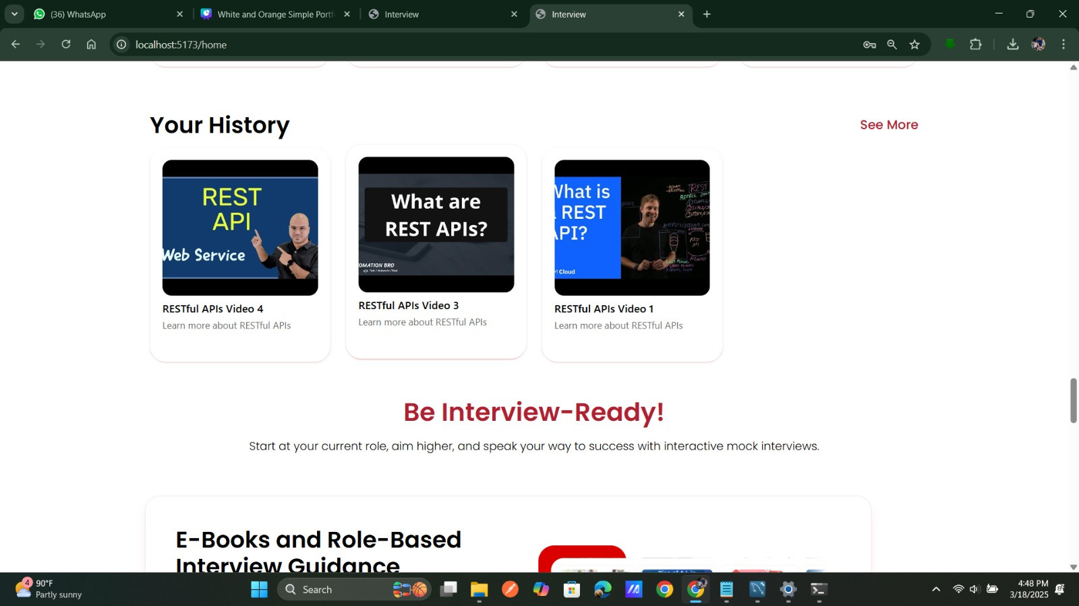
Evidence of Completion
3/19/2025
43

Slide 44
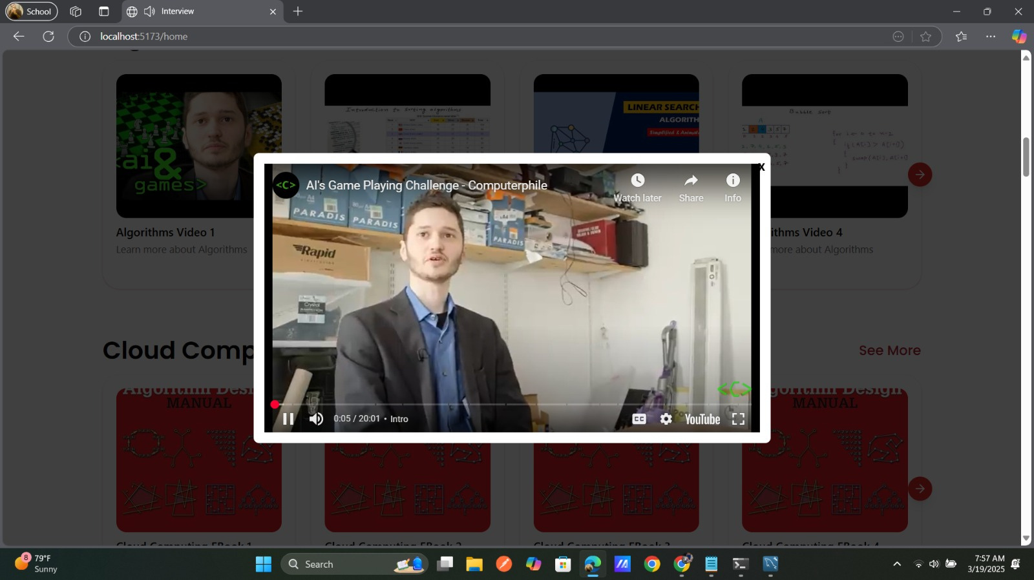
Evidence of Completion
3/19/2025
44

Slide 45
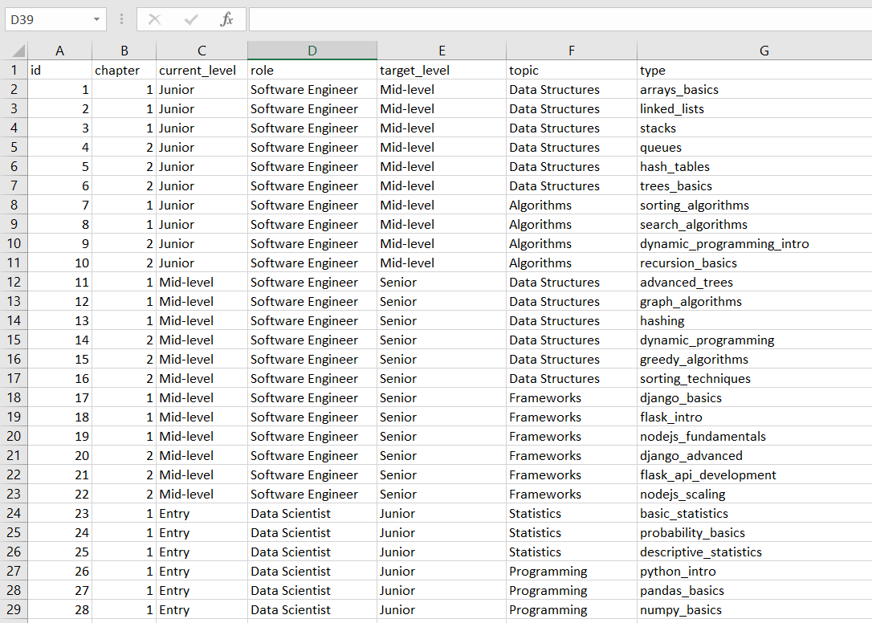
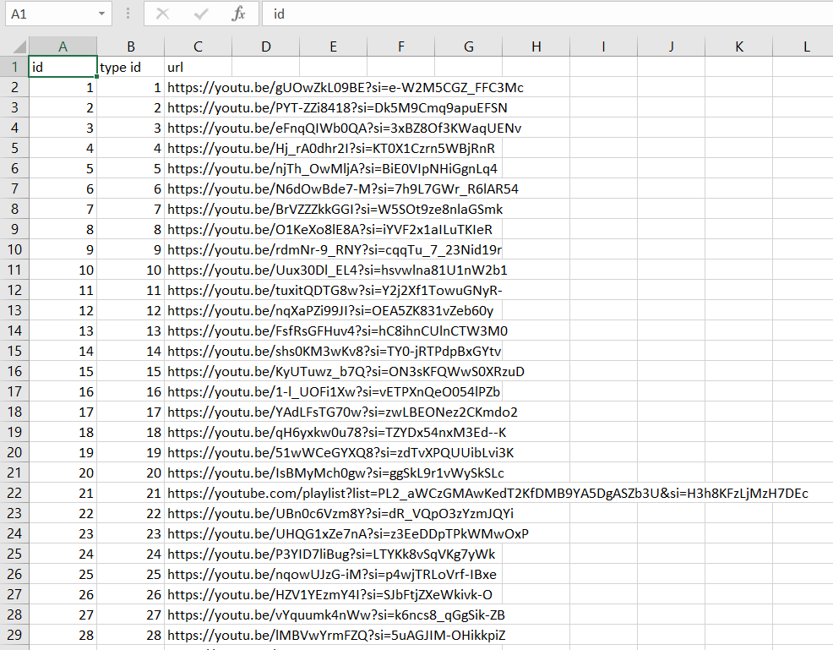
Evidence of Completion
Data Collection
3/19/2025
45

Slide 46
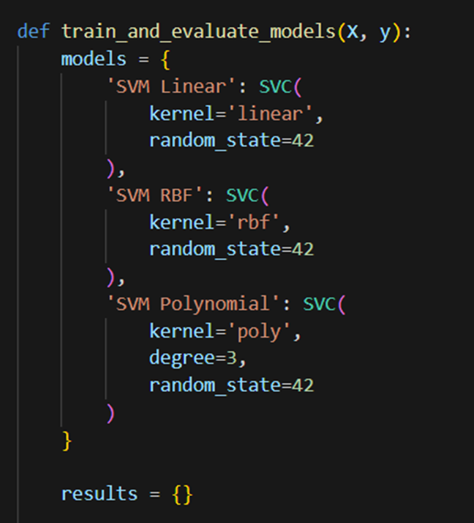
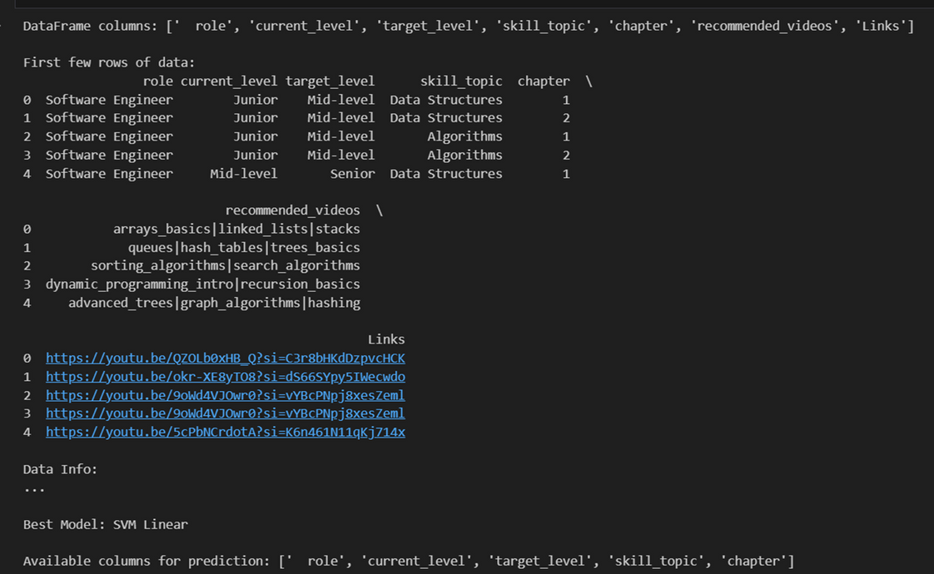
Evidence of Completion
Model Accuracy and Training
3/19/2025
46

Slide 47
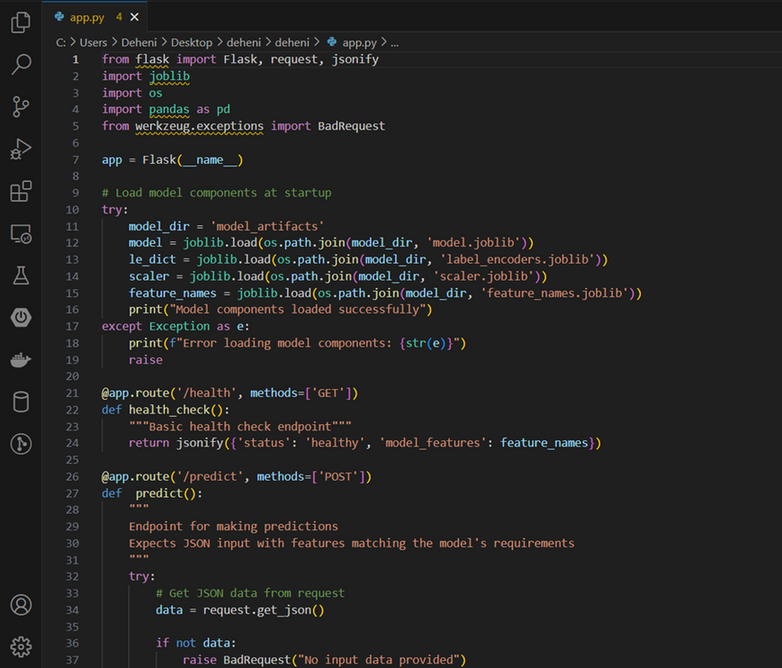
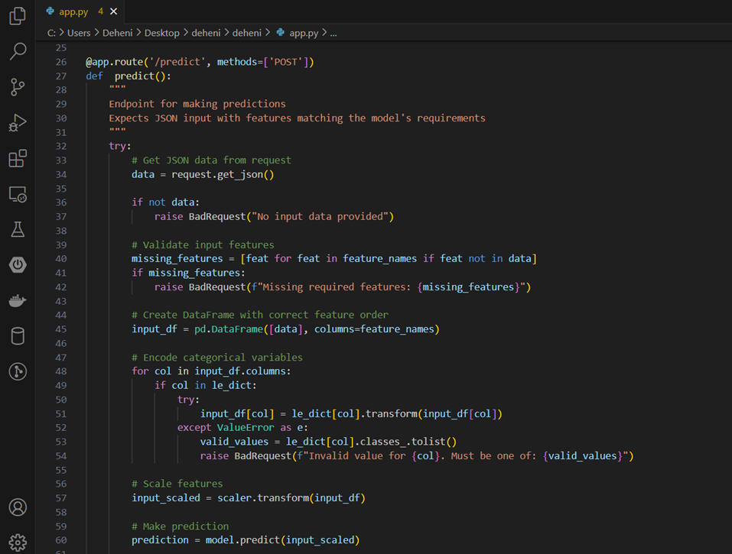
Evidence of Completion
Flask Backend
3/19/2025
47

Slide 48
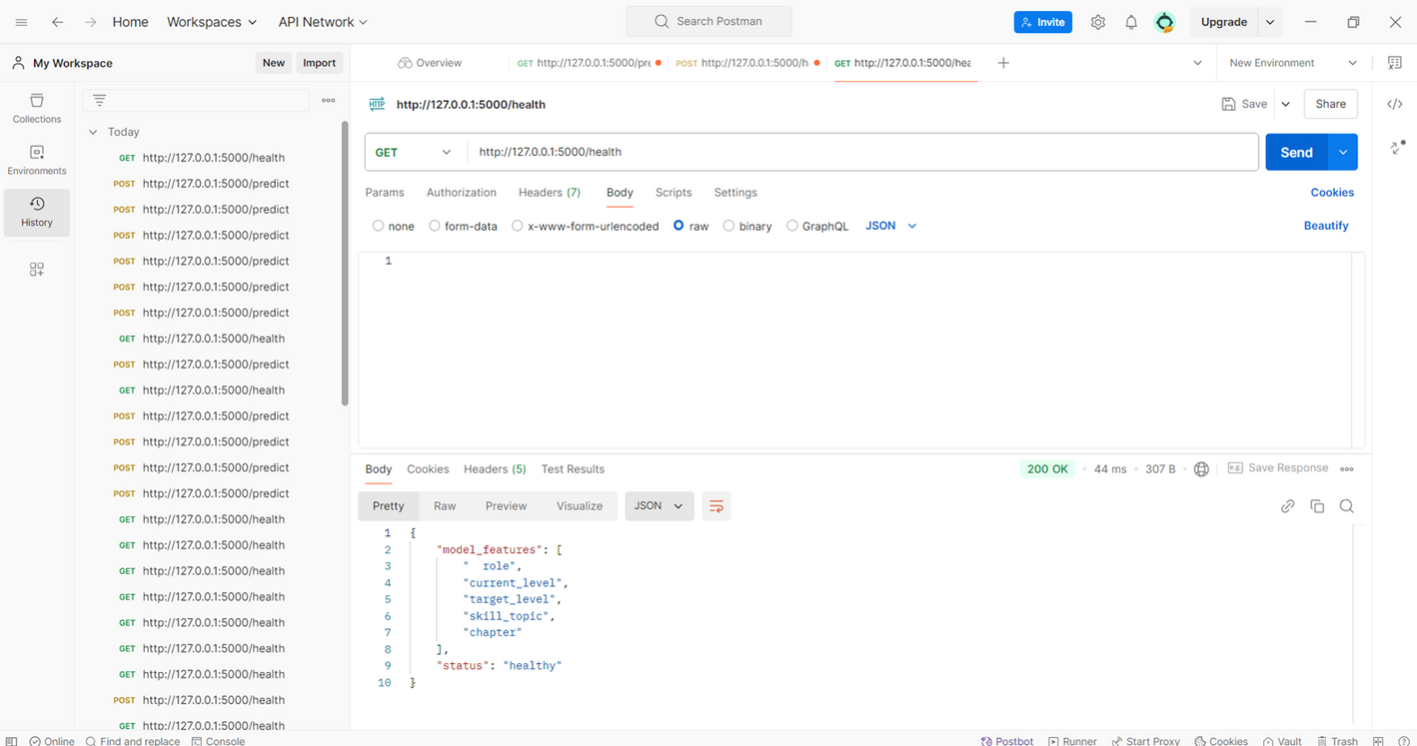
Evidence of Completion
Postman
3/19/2025
48

Slide 49
Progress
Completion of the Component
Data Collection
Data Pre-processing
Model Development
Front-End Development
Backend Development
Web Application Development (90%)
Integrate Component
Future Implementation
Web Application Development (10%)
Testing and Deployment
develop the skill cycle
3/19/2025
49

Slide 50
Functional Requirements
•Video Interview Functionality
•Tutorial Functionality
•User Management
•Integration and Compatibility
•Real-Time Feedback
3/19/2025
50

Slide 51
Non-Functional Requirements
•Performance
•Usability
•Reliability
•Maintainability
•Security
3/19/2025
51

Slide 52
References
[1]N. Roulin, "Is More Always Better? How Preparation Time and Re-recording Opportunities Impact Fairness, Anxiety, Impression Management, and Performance in Asynchronous Video Interviews," Journal of Business and Psychology, vol. 36, no. 4, pp. 599-617, 2021.
[2]L. Barrick and C. Mount, "Interactive Tutorials for Online Job Interview Preparation: An Empirical Evaluation," IEEE Transactions on Learning Technologies, vol. 13, no. 3, pp. 329-340, 2020.
[3]"Ensuring Accessible Digital Interviews," Peatworks, 2020. This article outlines accessibility-related challenges and provides solutions for making digital interviews fairer and more inclusive.
[4]M. Sharma and K. Thakur, "Leveraging AI for Real-Time Feedback in Video Interviews," IEEE Access, vol. 9, pp. 123456-123467, 2021.
3/19/2025
52

Slide 53

IT21286650 | Senevirathna D M O C
Specialization - Information Technology
Component 3 - MCQ Levelup System
3/19/2025
53

Slide 54
Introduction
The MCQ Levelup Controlling component aims to enhance interview preparation by providing a dynamic, adaptive system of multiple-choice questions (MCQs).
Traditional interview preparation methods lack personalization and adaptability, often failing to meet individual learning needs and job-specific requirements.
There is a need for innovative solutions that offer tailored preparation experiences and real-time feedback.
The MCQ Levelup Controlling component addresses this gap by providing an adaptive learning system that evolves with user performance, enhancing readiness and confidence for job interviews through personalized, relevant content.
3/19/2025
54

Slide 55

Research Gap
Traditional interview preparation methods lack personalization and adaptability, often failing to address individual learning needs and proficiency levels.
The MCQ Levelup Controlling component aims to fill this gap by providing a dynamic, role-specific, and adaptive question system that offers real-time feedback and progressive difficulty adjustment.
3/19/2025
55

Slide 56
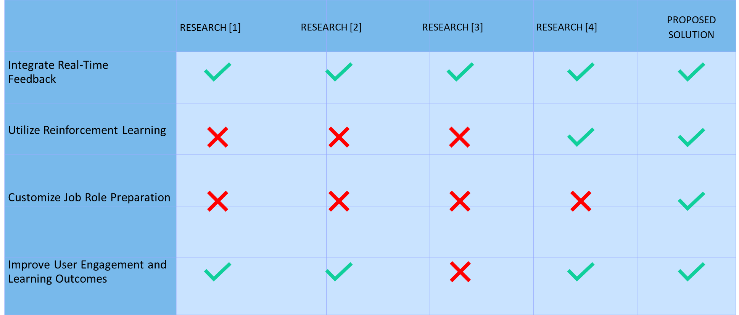
Research Gap
3/19/2025
56

Slide 57

Research Problem
How can an adaptive MCQ system be designed to personalize interview preparation by dynamically tailoring questions to individual job roles and proficiency levels, providing real-time feedback, and adjusting the difficulty based on user performance?
3/19/2025
57

Slide 58
Specific Objectives
To develop and implement the MCQ Levelup Controlling component within a comprehensive web application that enhances interview preparedness through machine learning techniques.
3/19/2025
58

Slide 59

Sub Objectives
Job Role Customization
Dynamic Difficulty Adjustment
Reinforcement Learning Integration
Question Bank Management
User Interface Design
Performance Monitoring
3/19/2025
59

Slide 60
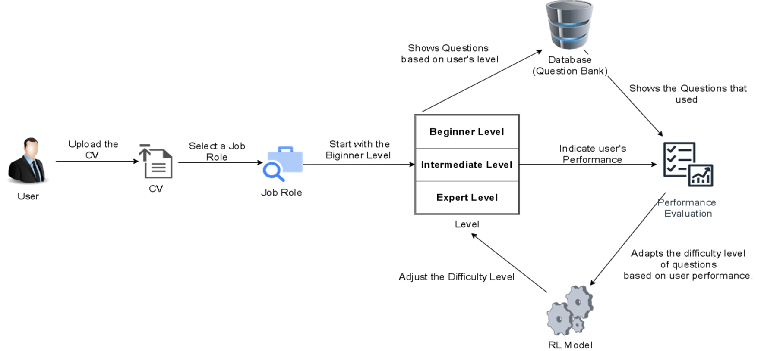
System Diagram
3/19/2025
60

Slide 61
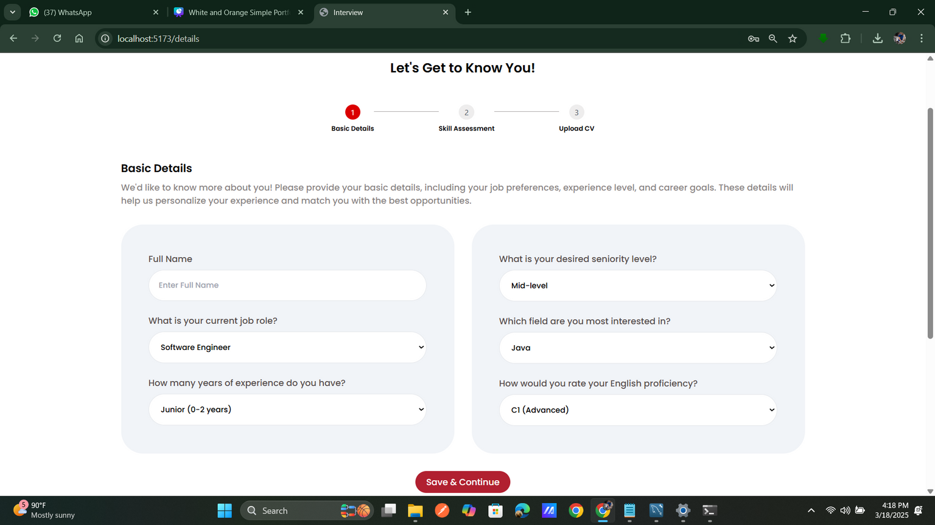
Evidence of Completion
Web Application UI
3/19/2025
61

Slide 62
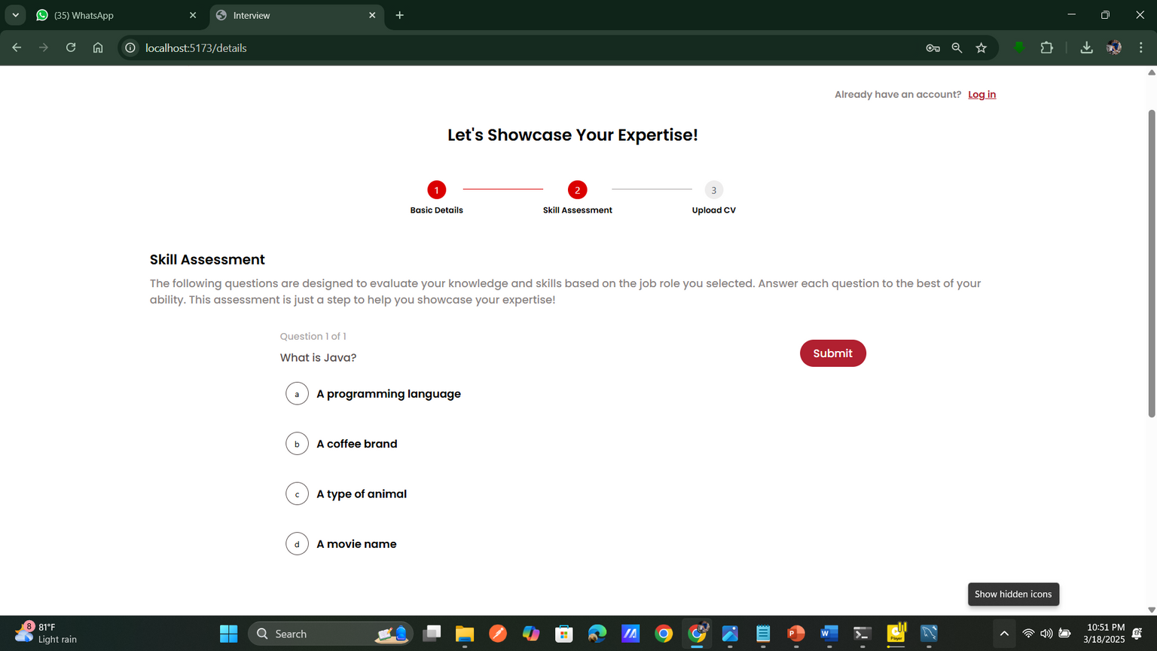
Evidence of Completion
Web Application UI
3/19/2025
62

Slide 63
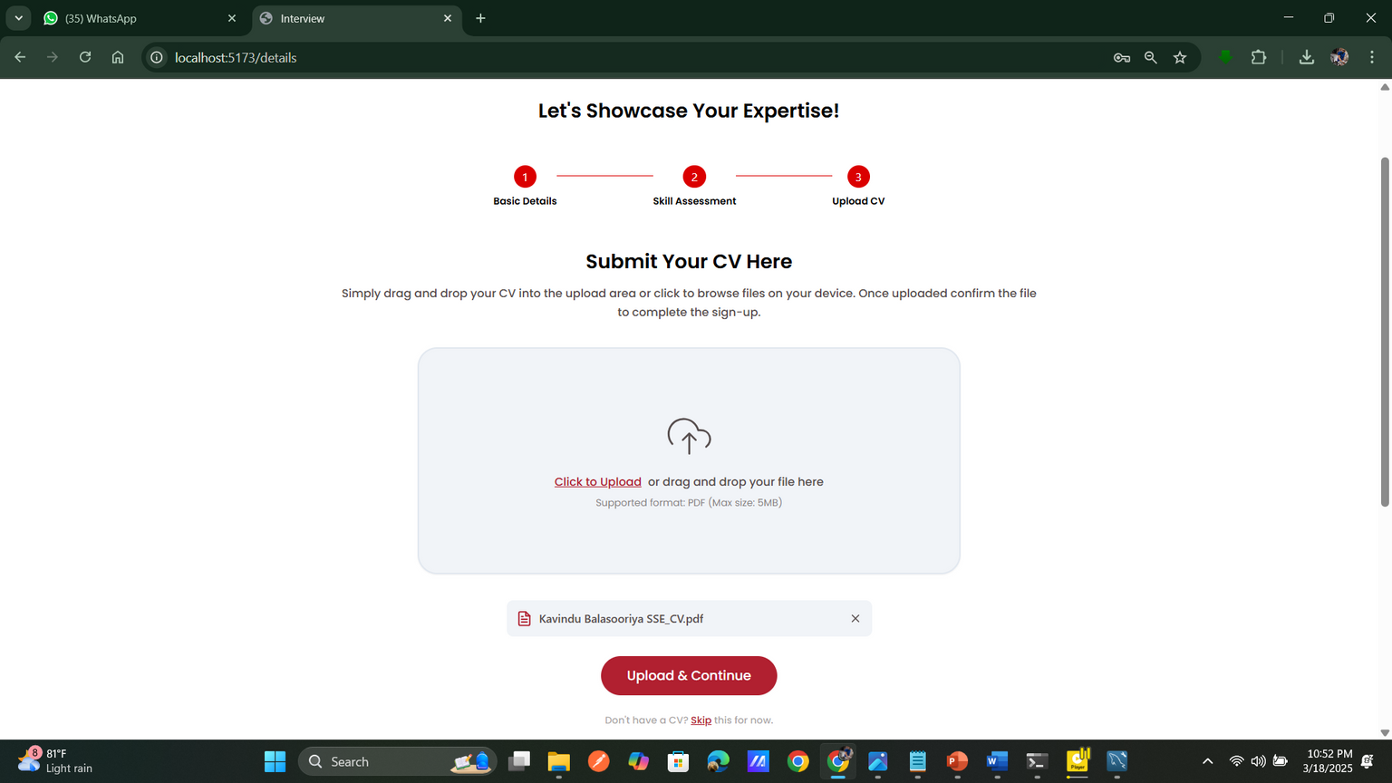
Evidence of Completion
Web Application UI
3/19/2025
63

Slide 64
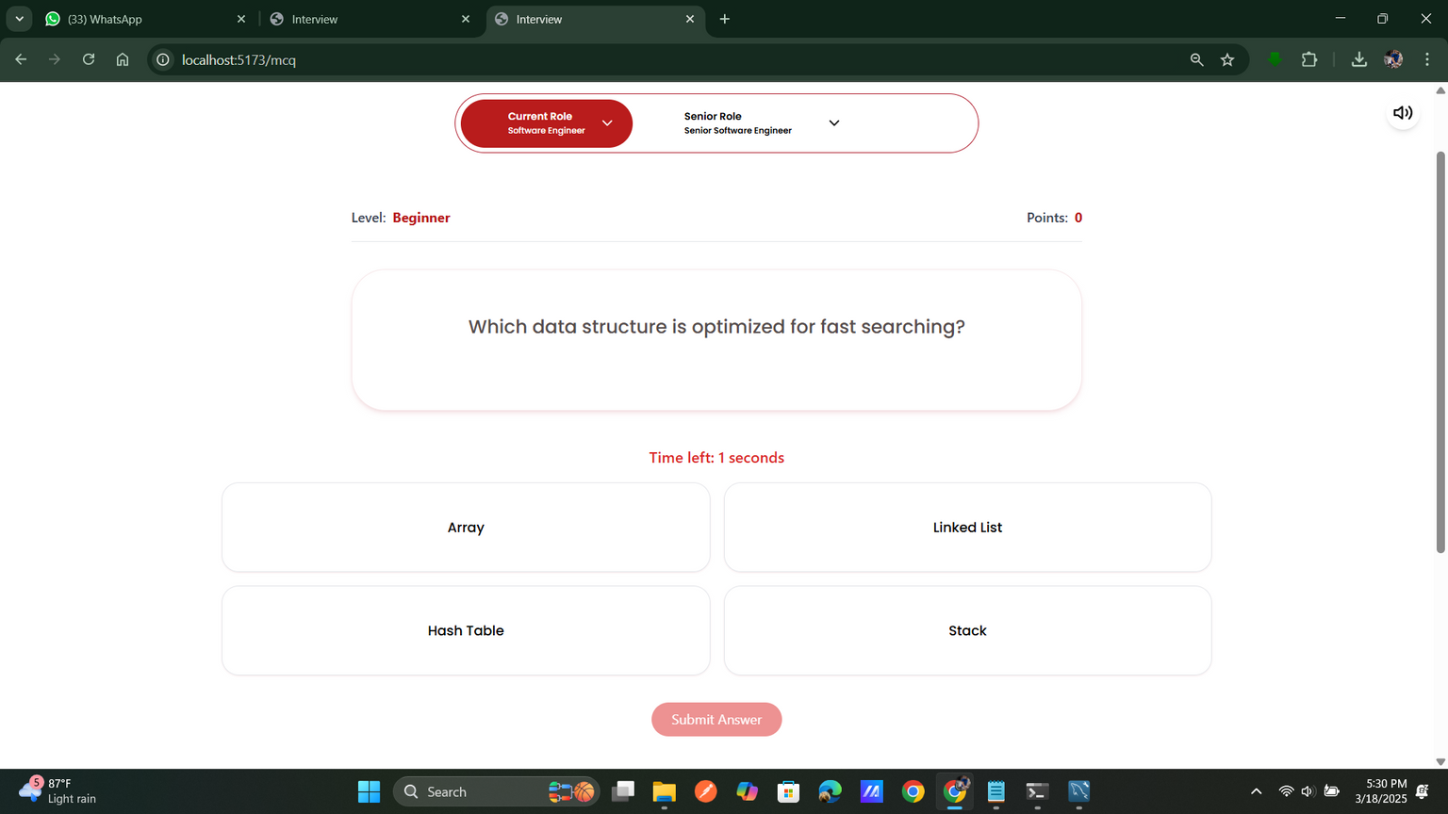
Evidence of Completion
Web Application UI
3/19/2025
64

Slide 65
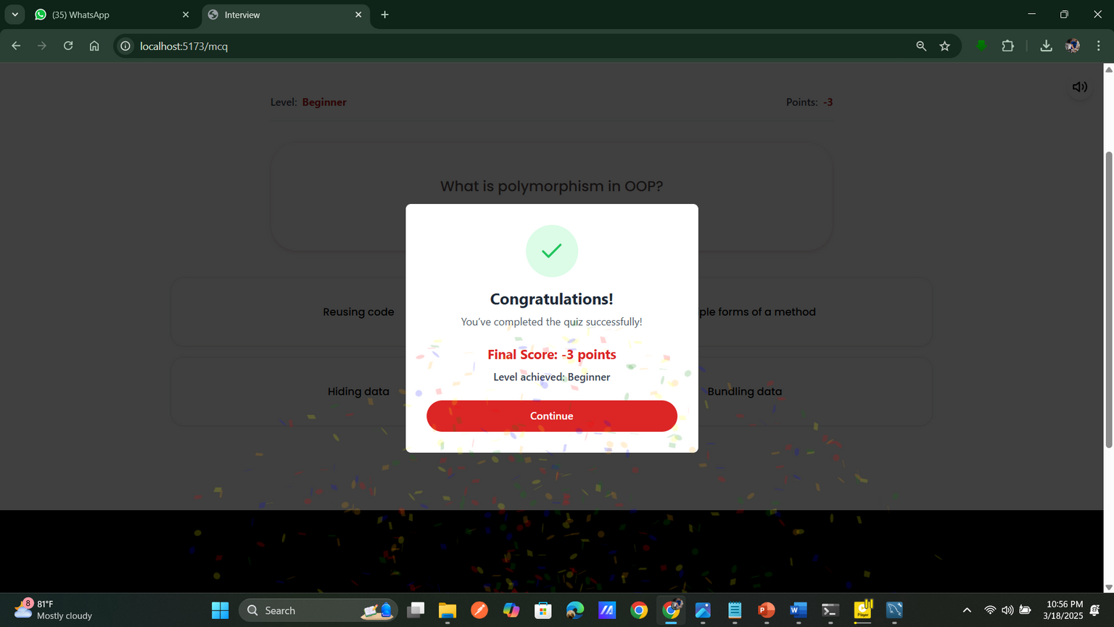
Evidence of Completion
Web Application UI
3/19/2025
65

Slide 66
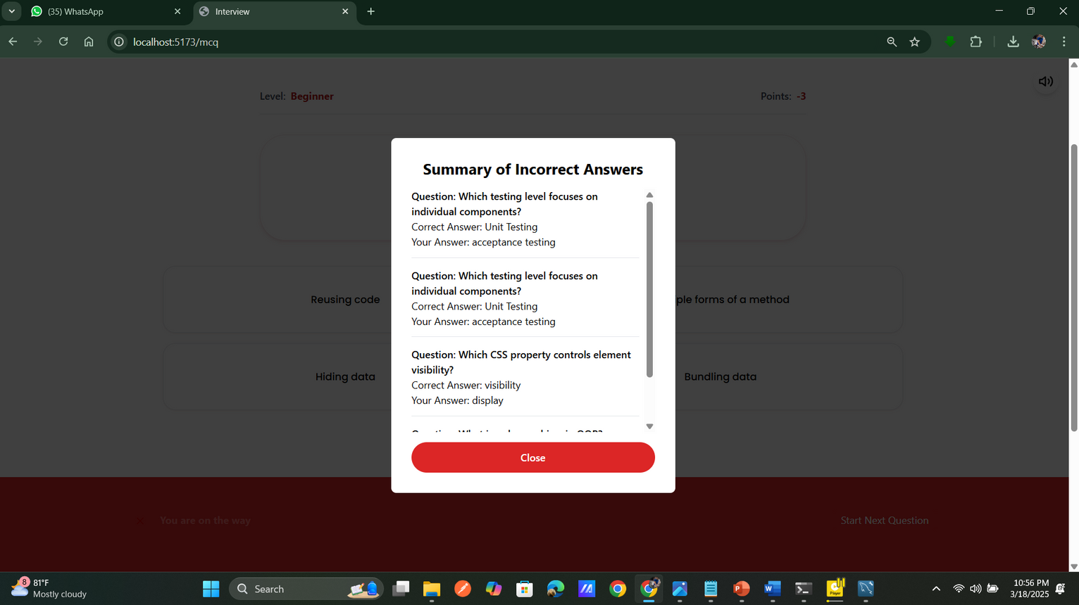
Evidence of Completion
Web Application UI
3/19/2025
66

Slide 67
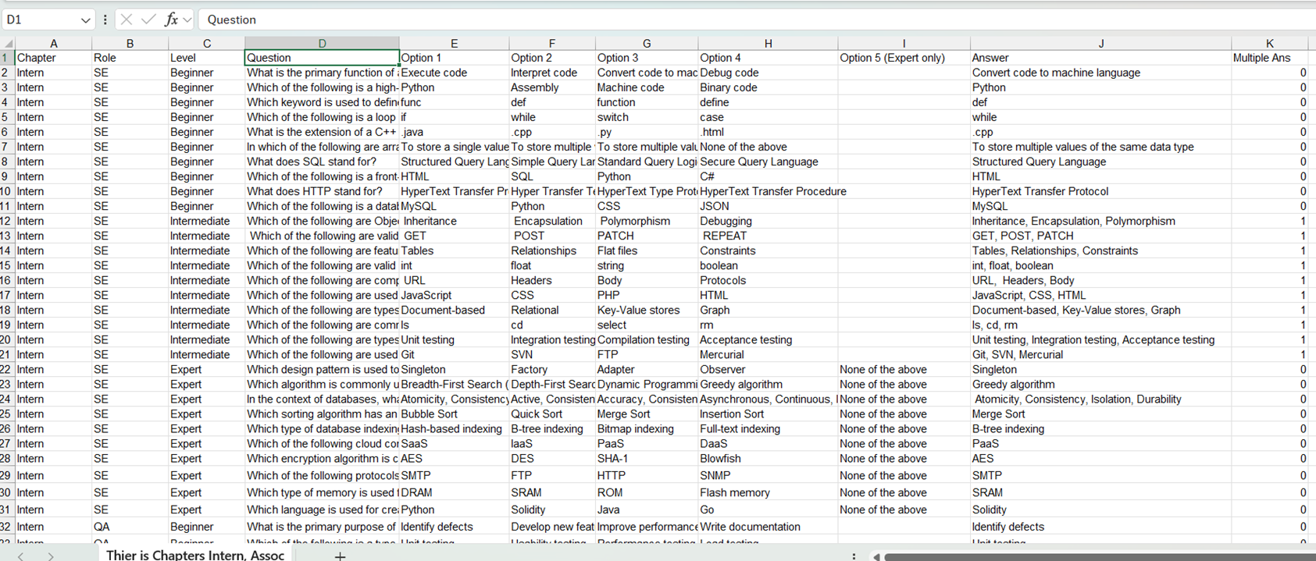
Evidence of Completion
Data Collection
3/19/2025
67

Slide 68
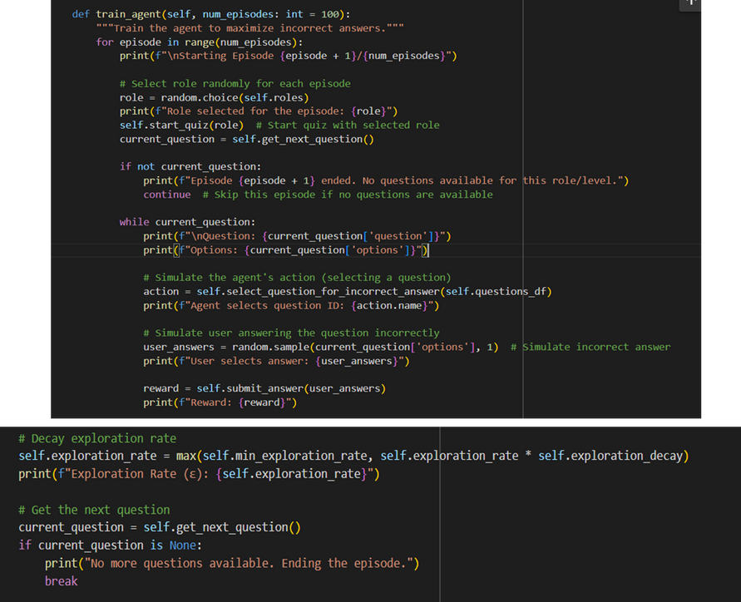
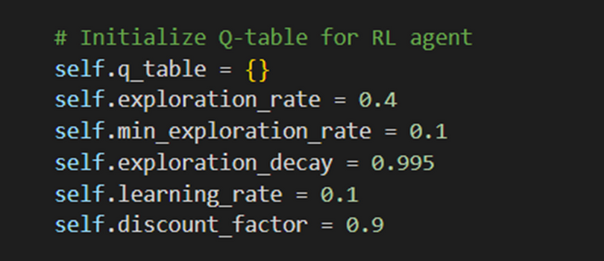
Evidence of Completion
Implementation - Code Snippets
RL Variables
Train Agent
3/19/2025
68

Slide 69
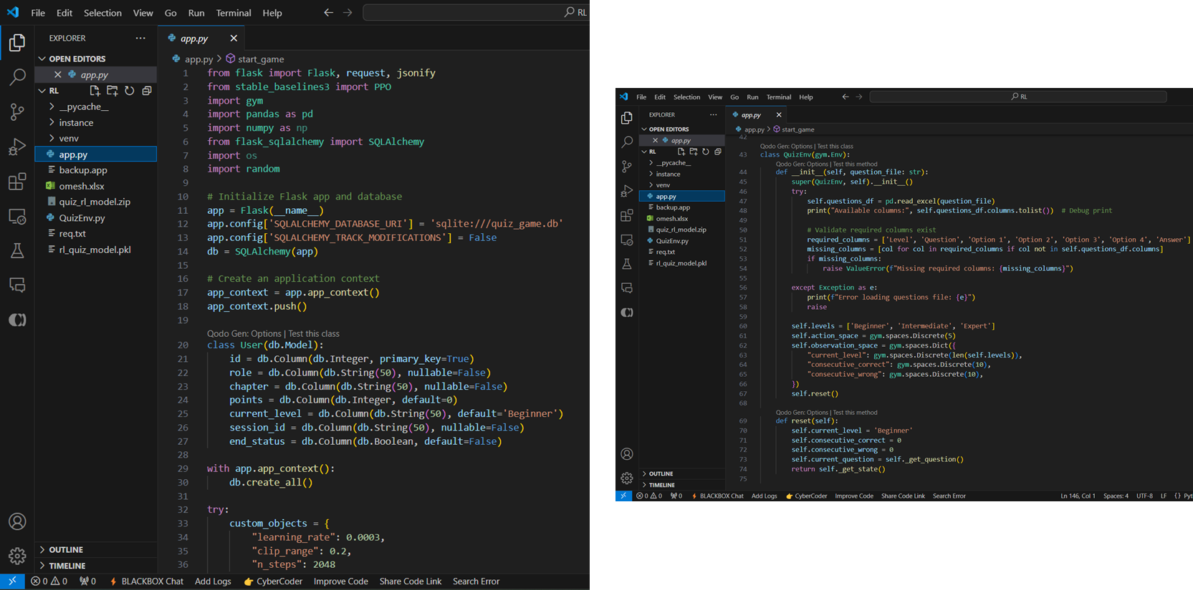
Evidence of Completion
Implementation - Code Snippets
Flask Backend
3/19/2025
69

Slide 70
Progress
Completed Tasks
•Data Collection
•Data Pre-processing
•Model Development
•Backend Development
•Web Application Development (90%)
•Integrate Components
Future Works
Web Application Development (10%)
Enhance UI and UX
3/19/2025
70

Slide 71
Functional Requirements
User Role Selection
Adaptive Difficulty
Three-Level Difficulty System
Progress Tracking
Question Bank Management
Reinforcement Learning
3/19/2025
71

Slide 72
Non-Functional Requirements
Performance
Scalability
Reliability
Usability
3/19/2025
72

Slide 73
CHALLENGES
Training the reinforcement learning model to adapt difficulty accurately based on user performance.
Designing a natural and responsive interface for users to easily navigate through role and level selections.
Manually created question bank.
3/19/2025
73

Slide 74
References
[1] S. K. ,. T. T. ,. W. W. G. M. V. S. ,. W. M. K. ,. E. E. M. O. M. ,. K. S. R. M. J. S. Rajapaksha, "Guru Gedara: Smart Mathematical e-learning Platform for Grade Five Students,” INTERNATIONAL CONFERENCE ON ADVANCED RESEARCH IN COMPUTING;, 21 February 2021.
[2] T. Alsubait, B. Parsia and U. Sattler, "A similarity-based theory of controlling MCQ difficulty," 2013 Second International Conference on E-Learning and E-Technologies in Education (ICEEE), Lodz, Poland, 2013, pp. 283-288, doi: 10.1109/ICeLeTE.2013.6644389.
[3] D. R. CH and S. K. Saha, "Automatic Multiple Choice Question Generation From Text: A Survey," in IEEE Transactions on Learning Technologies, vol. 13, no. 1, pp. 14-25, 1 Jan.-March 2020, doi: 10.1109/TLT.2018.2889100.
[4] C. N. Hang, C. Wei Tan and P. -D. Yu, "MCQGen: A Large Language Model-Driven MCQ Generator for Personalized Learning," in IEEE Access, vol. 12, pp. 102261-102273, 2024, doi: 10.1109/ACCESS.2024.3420709.
3/19/2025
74

Slide 75

IT21175084 | Pathirana V.P.E.P.V
Specialization - Information Technology
Component 4 - 2D Interview Panel Simulation
3/16/2025
75

Slide 76
Introduction
AI-Driven Interview Evaluation
Uses advanced NLP techniques to analyze responses and provide instant feedback for better learning.
Realistic 2D Interview Simulation
Features 2D avatars that adapt questions based on performance, creating a personalized interview experience.
Smarter & More Effective Preparation
Enhances confidence and readiness with adaptive questioning and role-specific practice, making interviews easier and more interactive.
3/19/2025
76

Slide 77
Research Gap
Advanced Design Techniques for Realistic 2D Avatar.
Efficient Integration of ML Models with 2D Simulation Systems.
User Engagement Strategies in 2D Practice Environments
Ensuring Accuracy, Reliability, and Effectiveness in 2D Interview Simulations
3/19/2025
77

Slide 78
Research Gap
 | RESEARCH [1] | RESEARCH [2] | RESEARCH [3] | PROPOSED SOLUTION
Advanced Design Techniques for Realistic 2D Avatar
Efficient Integration of ML Models with 2D Simulation Systems.
User Engagement Strategies in 2D Practice Environments
3/19/2025
78

Slide 79
Research Problem
•How to develop a 2D interview panel that accurately simulates human interviewers using advanced NLP techniques like cosine similarity,
BERT-based semantic analysis, and TF-IDF vectorization to generate contextually relevant questions and responses.
•How to ensure the system dynamically adapts interview questions based on user performance and selected difficulty levels (Beginner, Intermediate, Expert) for realistic and effective practice sessions.
3/19/2025
79

Slide 80
Specific Objectives
Develop an Interactive 2D Interview Panel Simulation
Provide User-Friendly Interface and Experience
3/19/2025
80

Slide 81
Sub Objectives
•Create lifelike 2D avatars.
•Develop Beginner, Intermediate, and Expert interview levels.
•Integrate machine learning components into the system.
•Test and validate the simulation for realism and effectiveness.
3/19/2025
81

Slide 82
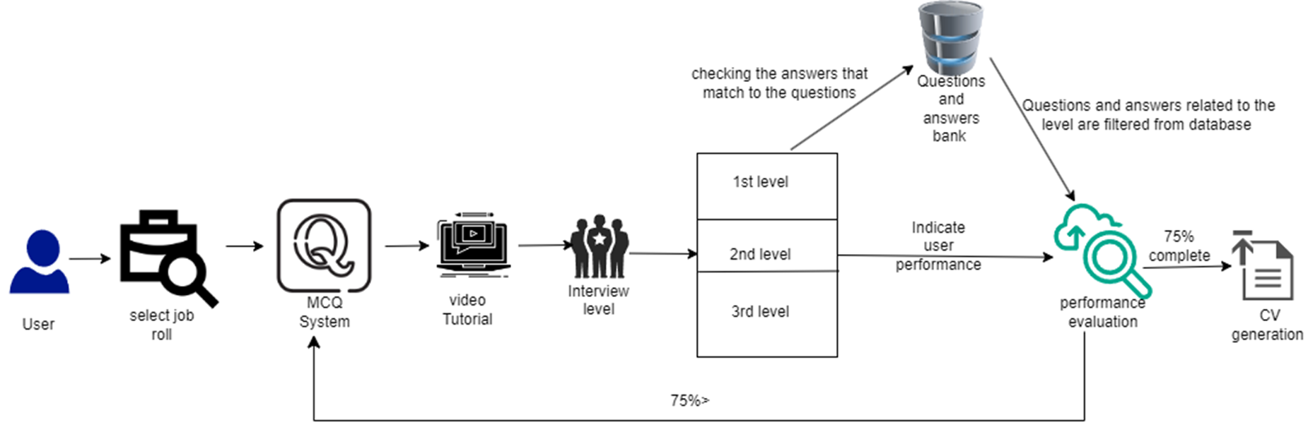



System Diagram
3/19/2025
82

Slide 83
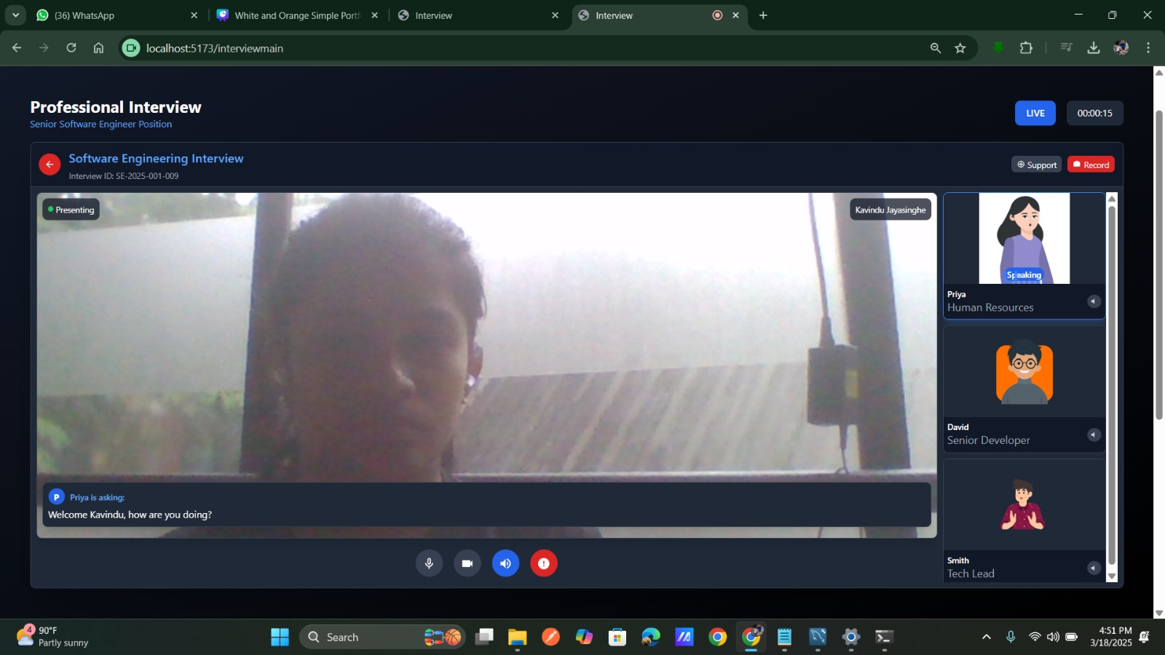
Evidence of Completion
Web Application UI
3/19/2025
83

Slide 84
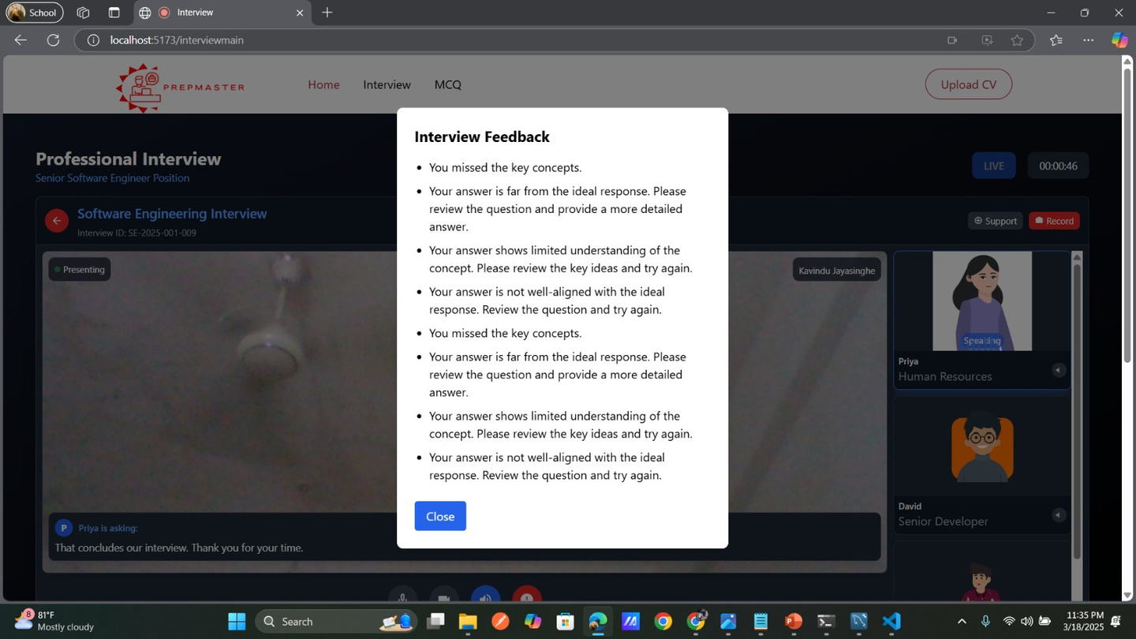
Evidence of Completion
Web Application UI
3/19/2025
84

Slide 85

Evidence of Completion
Web Application UI
3/19/2025
85

Slide 86


Evidence of Completion
DATA PREPROCESING
3/19/2025
86

Slide 87


Evidence of Completion
Co- sign Similarity
TF IDE
Semantic_ model
Semantic_ model
DATA PREPROCESING
3/19/2025
87

Slide 88


Evidence of Completion
Interview start session
and
End session
3/19/2025
88

Slide 89


Evidence of Completion
FLASK BACKEND
3/19/2025
89

Slide 90

Evidence of Completion
POSTMAN
3/19/2025
90

Slide 91

Commercialization
3/19/2025
91

Slide 92
Progress
Complete Tasks
•Data Pre-processing
•Model Development
•Backend Development
•Web Application Development (90%)
•Collect More Data
•Front-End Development
•Integrate Components
•Voice tracking Development
Future Works
Generate feedback through the voice for Each Question answers .
web Development (10%)
Data Collection
3/19/2025
92

Slide 93
CHALLENGES
Noice Environment Problems
Manually Question Bank Development
Frontend Development
3/19/2025
93

Slide 94
Functional Requirements
• User Authentication and Profile Management
• Interview Simulation Levels
• Question Generation and Feedback
• Progress Tracking and Analytics
Interactive 2D Avatars
3/19/2025
94

Slide 95
Non-Functional Requirements
•Performance and Scalability
•Usability and User Experience
•Reliability and Availability
•Maintainability and Extensibility
• Security and Privacy
3/19/2025
95

Slide 96
References
[1] S. K. ,. T. T. ,. W. W. G. M. V. S. ,. W. M. K. ,. E. E. M. O. M. ,. K. S. R. M. J. S. Rajapaksha, "Guru Gedara: Smart Mathematical e-learning Platform for Grade Five Students,” INTERNATIONAL CONFERENCE ON ADVANCED RESEARCH IN COMPUTING;, 21 February 2021.
[2] T. Alsubait, B. Parsia and U. Sattler, "A similarity-based theory of controlling MCQ difficulty," 2013 Second International Conference on E-Learning and E-Technologies in Education (ICEEE), Lodz, Poland, 2013, pp. 283-288, doi: 10.1109/ICeLeTE.2013.6644389.
[3] D. R. CH and S. K. Saha, "Automatic Multiple Choice Question Generation From Text: A Survey," in IEEE Transactions on Learning Technologies, vol. 13, no. 1, pp. 14-25, 1 Jan.-March 2020, doi: 10.1109/TLT.2018.2889100.
[4] C. N. Hang, C. Wei Tan and P. -D. Yu, "MCQGen: A Large Language Model-Driven MCQ Generator for Personalized Learning," in IEEE Access, vol. 12, pp. 102261-102273, 2024, doi: 10.1109/ACCESS.2024.3420709.
3/19/2025
96

Slide 97

Gantt Chart
3/19/2025
97

Slide 98
CHALLENGES
Data Collection Issues
Answer Analysis Type
Resource Limitations
Combining NLP Methods
Presentation Challenges
Model Training and Accuracy
User Experience and Interface
Incomplete or Missing Metadata
User Feedback Quality Issues
Low-Quality Video Content
3/19/2025
98

Slide 99
Thank you

